Slide 1
Advanced - Topic 2 – Using and Sharing Documents
Starter
Open up your Topic 2 Document from your My Documents – Introduction folder. Help others.
Username – 21SmithJ@croftonschool.co.uk
Password (You chose this last lesson and wrote it on the Topic 1 PowerPoint)

Slide 2
Mastery Statements Level 6 – 7
Mastery 6
I can combine multiple digital devices, internet services and application software to create information about Office 365.
I can evaluate the trustworthiness of digital content and consider the usability of visual design features when designing and creating digital artefacts for adults.
I can design criteria for users to evaluate the quality of solutions, and can use the feedback from users to identify improvements and can make appropriate refinements to the solution.
I can identify and explain how the use of technology can impact on society.
Mastery 7 (Extension)
I can undertake creative projects that collect, analyse, and evaluate data to meet the needs of adults.
I can effectively design and create digital artefacts for a wider or remote audience.
I consider the properties of media when importing them into digital artefacts.
I can document user feedback, the improvements identified and the refinements made to the solution.
I can explain and justify how the use of technology impacts on society, from the perspective of social, economical, political legal, ethical and moral issues.

Slide 3
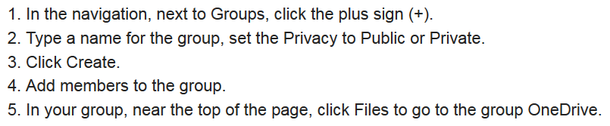
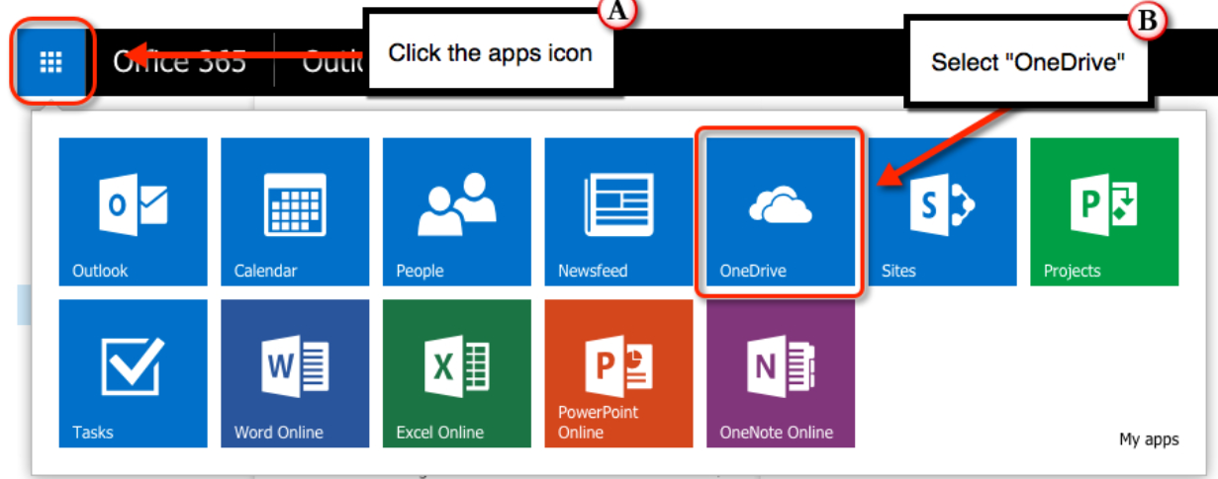
Advanced - Topic 2 – Using and sharing documents
?
Intermediate:
6 to 7
What is your target grade 6 or
7?:
Today we are going to use and share documents using Office 365.

Slide 4
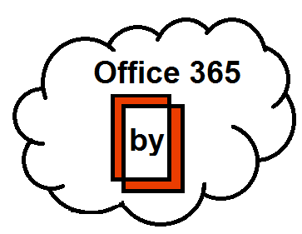
Topic 2 – Using and Sharing Documents
Task:
Using Office 365 create a shared document with at least one other member of the class.
Explain in your document the following:
What email is
How can you use your phone with Office 365 for school based information
How can you collaborate online?
What do all the apps allow you to do?
You could make your own image using the images online?
Make a report:
What did different software did use to make your information bulletin?
Who was the audience for the bulletin?
Who did you gain feedback from?
What feedback did you receive?
How did you respond to the feedback?
How safe is it to work online?
How trustworthy is Office 365?

Slide 5
Mastery Statements Level 6+
 | Self Ass Y/N
A
B
C
D
E
F
Mastery 6
6(1) I combined multiple digital devices, internet services and application software to create a bulletin about Office 365.
6(1) I used the criteria on slide 4 to make my bulletin.
6(1) I used text and images in my bulletin.
6(4) I gained feedback (1 x www)
6(4) I gained feedback (2 x ebi)
6(4) I made improvements to my work.

